Slide 1
Battle of Neighbourhoods
Chirag Patel

Slide 2
Motivation
It’s trend of globalization and technology
Data is generated at an enormous rate.
Data generated can be useful to predict certain outcomes and generate valuable insights from data.

Slide 3
Objective
Find out best neighbourhood in Toronto and New York.
Find out which investment will be most fruitful
Compare the Neighbourhood of New York and Toronto

Slide 4
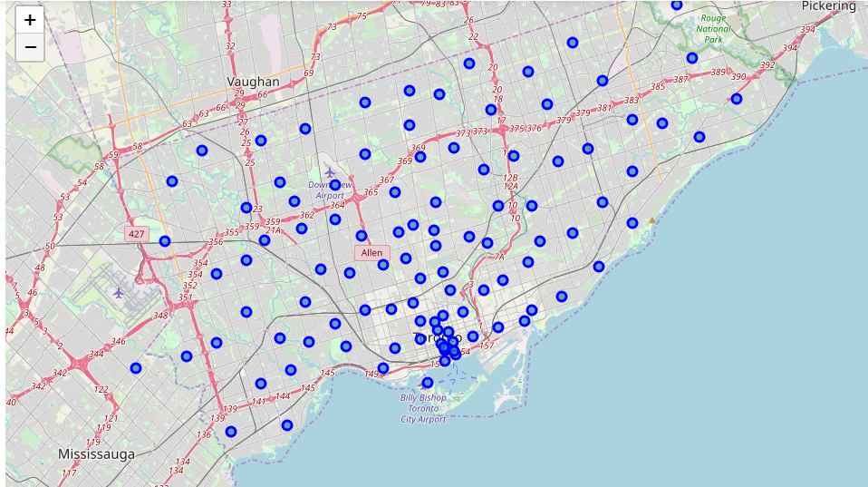
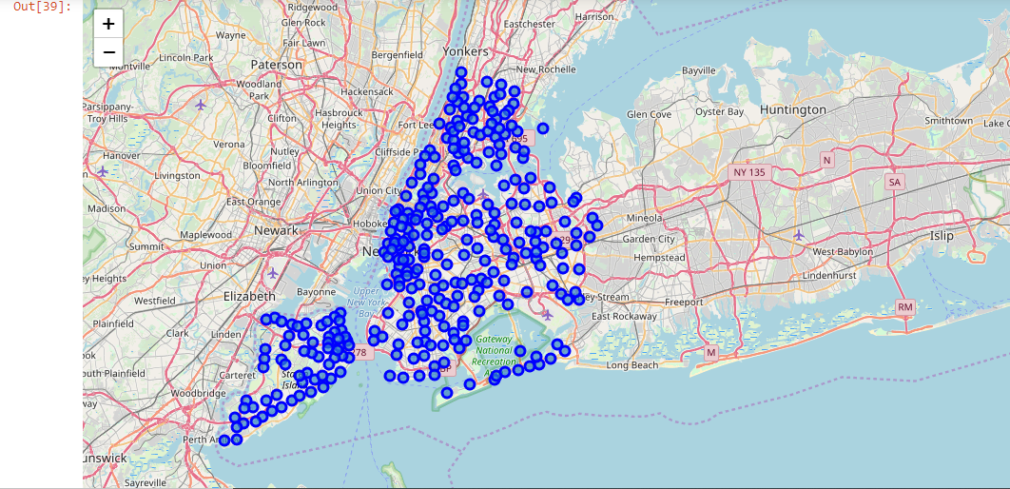
Visualization

Slide 5
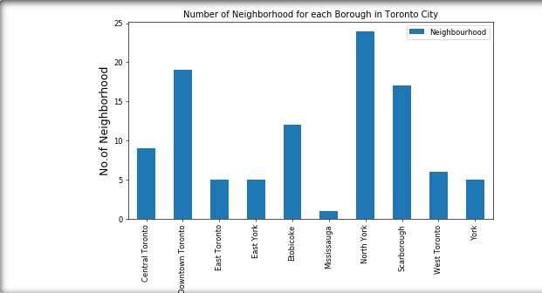
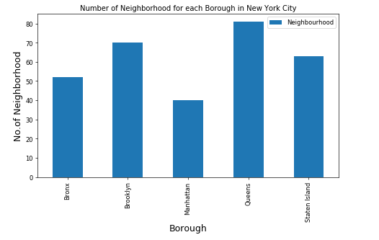
Best Neighbourhood
Best neighbourhood in Toronto is North York and Queens in New York

Slide 6
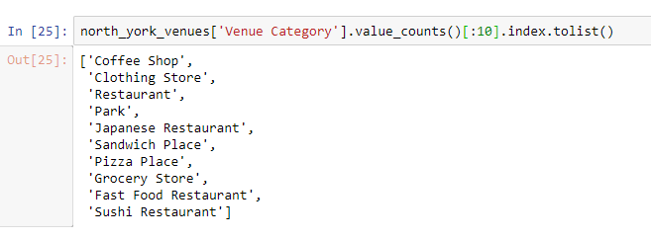
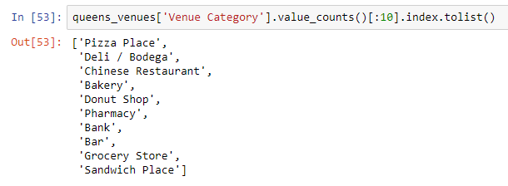
Top 10 most famous venue by neighbourhood

Slide 7
Conclusion
It can be concluded that most famous neighbourhood in Toronto is North York and Queens in New York
Hottest investment for Toronto is coffee shop while, for New York is Pizza Place.
This comparison also shows that people in Toronto have more inclination towards coffee while, Population in New York prefer Pizzas.
Thus investment should be made in coffee place in Toronto while in New York, Pizza place should be opened for maximum profit.

